Slide 1
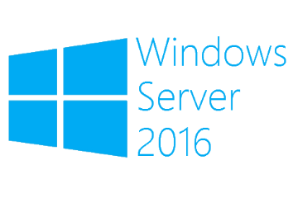
Hyper-V Live Migration
Megaseries

Slide 2
Info
Move a running VM from a Hyper-V server to another one without shutting the VM down and with minimal connectivity loss (maybe 1 or 2 pings depending on the migration type)

Slide 3
Migration types
Live migration in a failover cluster
Live migration with VM files stored on SMB share
Live storage migration
Shared nothing live migration

Slide 4
2012 R2 improvements
Live migration now uses compression which can speed up the migration time with a little CPU overhead
Live migration can also use SMB with multichannel and, where available, RDMA to make the migration even faster
Compression cannot be used together with SMB

Slide 5

https://www.youtube.com/channel/UCcZ-jLbPwNr8E_v9-65n8Iw https://github.com/itknowledge4

